Slide 1
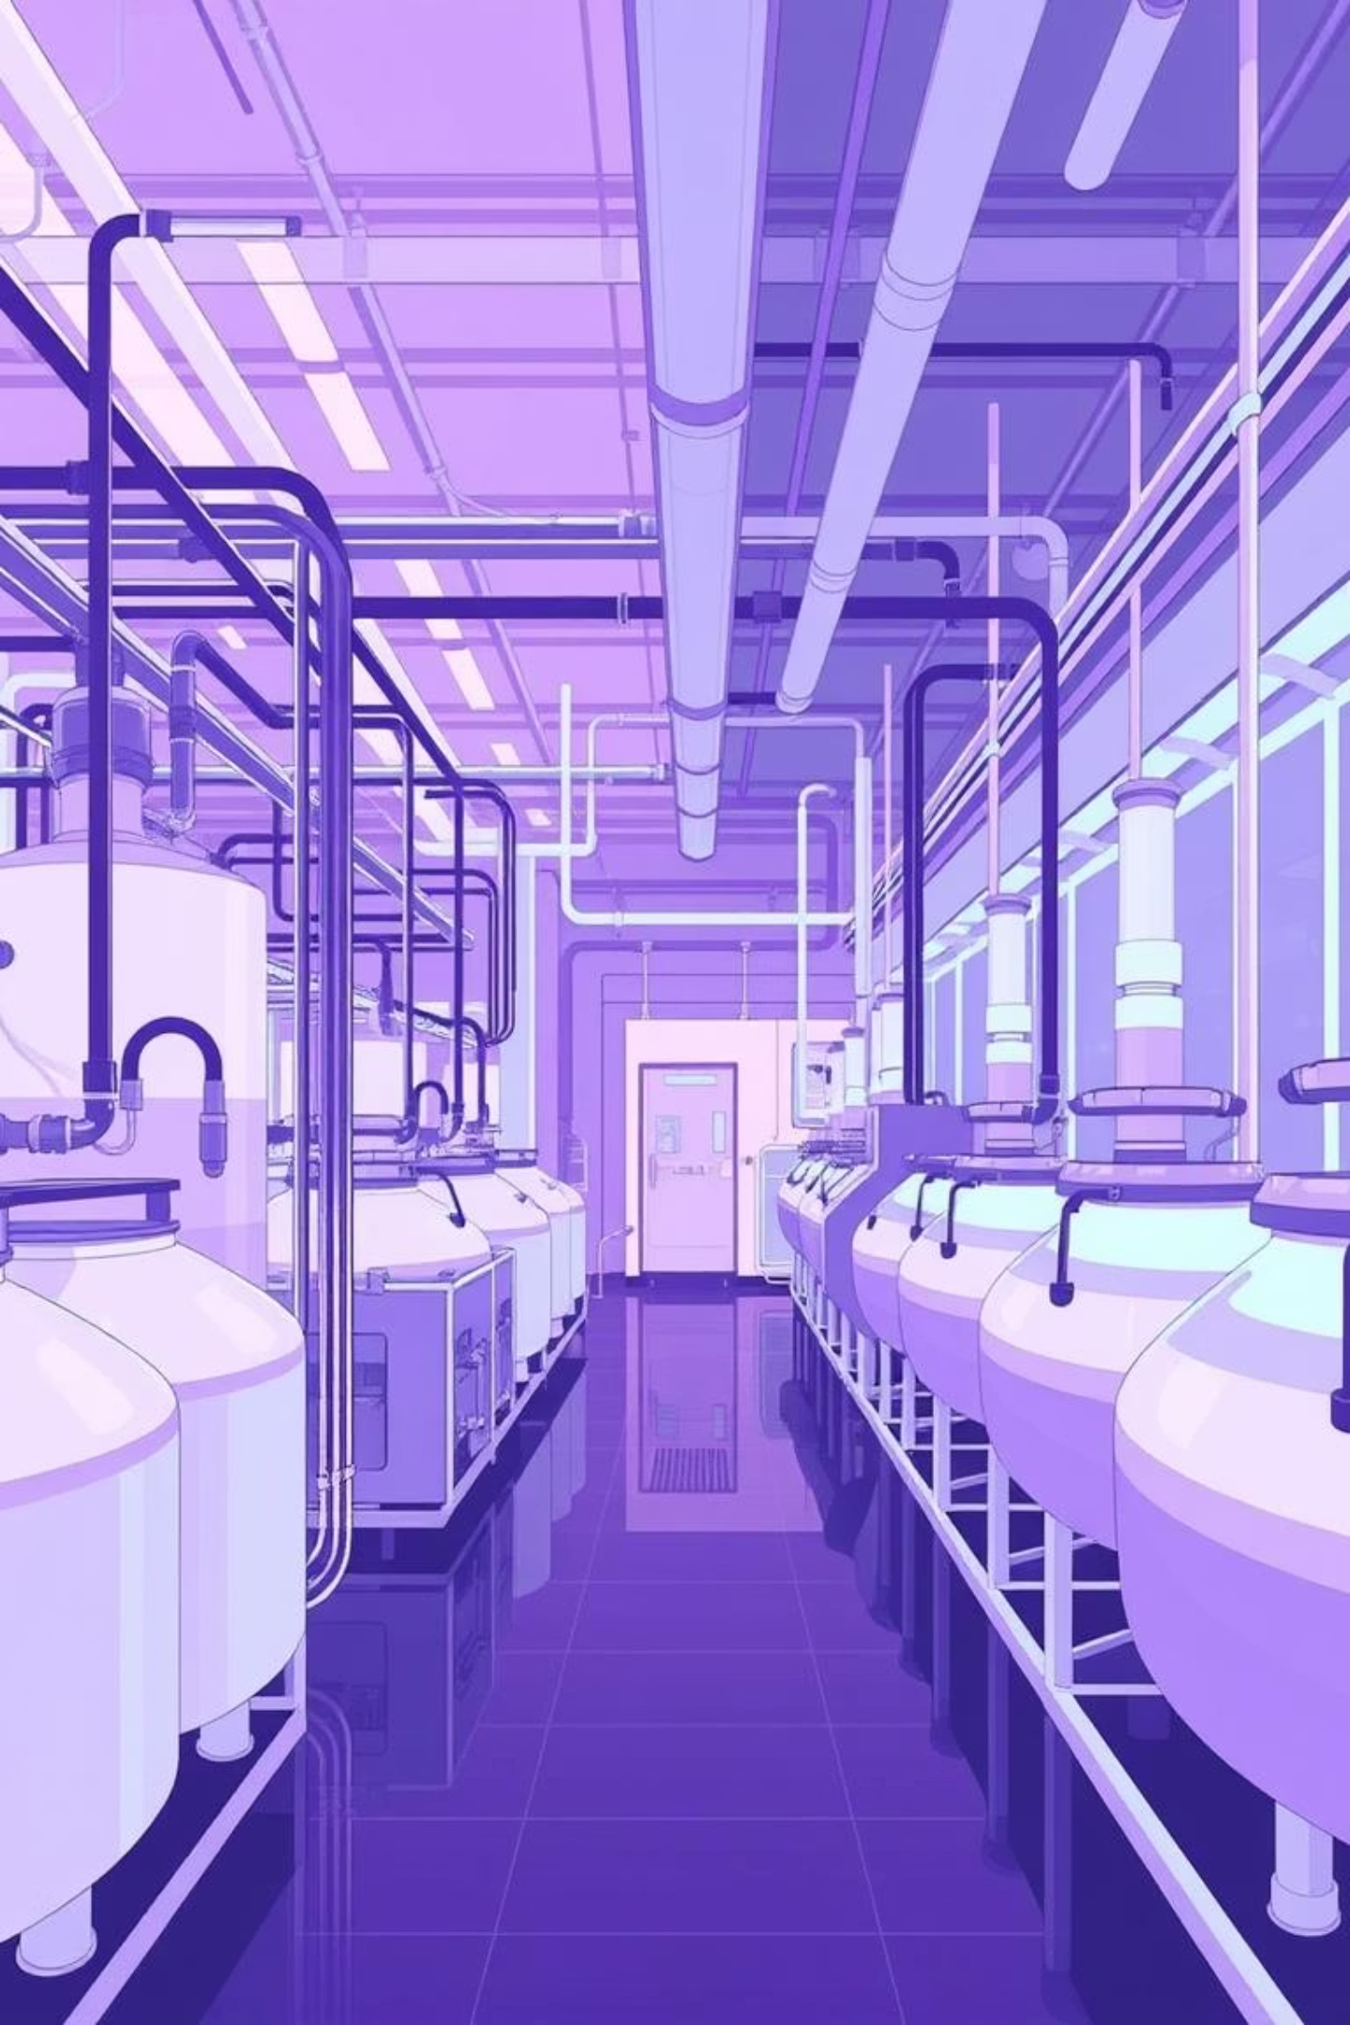
Bioprocess Downstream Processing
This presentation outlines the critical steps involved in downstream processing within biopharmaceutical manufacturing, focusing on the separation, concentration, purification, and final formulation of biological products.

Slide 2
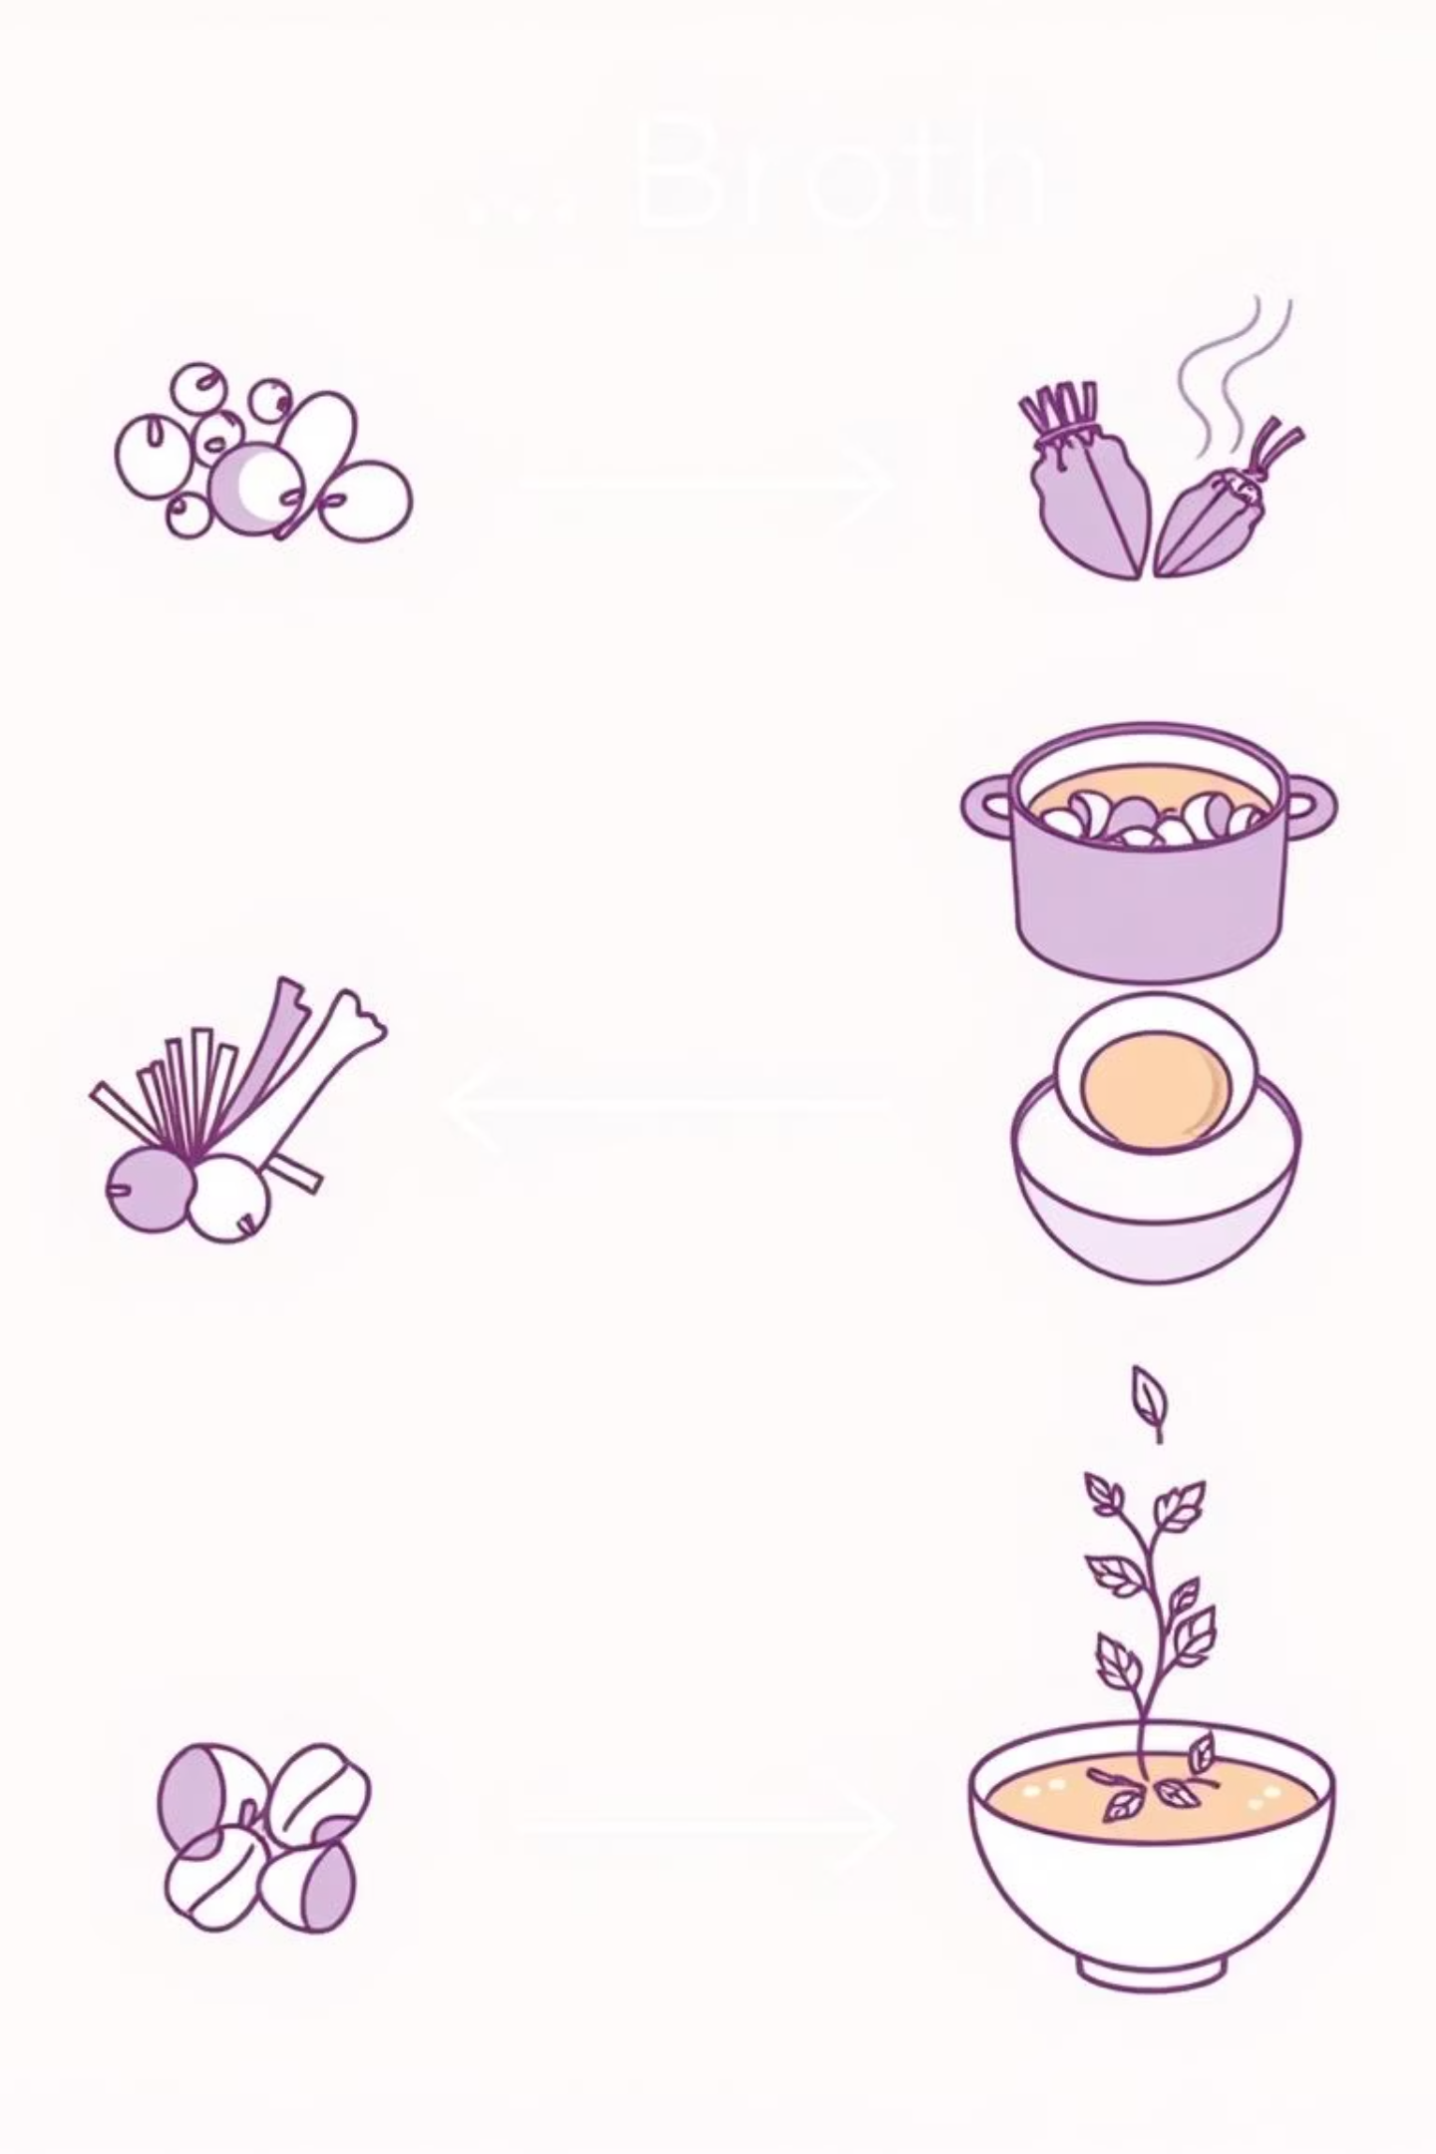




Downstream Processing: An Overview
Also called Product Recovery, DSP is complex and costly but crucial for obtaining a usable product.
Broth
Separation
Purification
Final Product

Slide 3

Initial Recovery & Cell Disruption
The first step depends on the product's location: extracellular or intracellular.
Extracellular Product (Secreted)
Intracellular Product (Inside Cells)
Product is in the liquid broth; proceed directly to Solid-Liquid Separation.
Requires Cell Disruption:
Mechanical: Shear forces (homogenizers).
Non-Mechanical: Chemical (detergents), Physical (freeze-thaw), Enzymatic (lysozyme).

Slide 4



Step 2: Separating Solids from Liquids
The primary goal is to clarify the broth by removing solids (cells or cell debris).
Filtration
Centrifugation
Coagulation & Flocculation
Passing the broth through a filter.
Using high-speed spin to separate by density.
Clump small particles together so they settle.

Slide 5
Common Methods for Solid-Liquid Separation
Beyond the primary techniques, other methods contribute to effective solid-liquid separation.
Flotation
Sedimentation
Membrane Separation
Making particles float to the surface for removal.
Allowing denser particles to settle naturally over time.
Utilizing semi-permeable membranes to separate components based on size.

Slide 6



Step 3: Concentrating and Isolating the Product
This stage focuses on reducing the volume of the solution and making the product more accessible for further purification.
Techniques for Product Concentration
Evaporation
Precipitation
Adsorption
Utilizes heat to remove water, significantly reducing the volume of the product solution.
Induces the product to become insoluble, causing it to separate from the solution as a solid.
Involves the product binding to specialized resins, allowing for its selective capture and concentration.

Slide 7



Purification (Increase Purity)
This is the main process for achieving high purity.
Chromatography: The Gold Standard for Purification
Chromatography techniques are essential for achieving the high purity required for biopharmaceutical products.
Ion-Exchange
Size-Exclusion
Affinity
Separates molecules based on their net charge.
Separates molecules based on their hydrodynamic volume.
Separates based on specific biological interactions.

Slide 8
Purification (Increase Purity)
This is the main process for achieving high purity.
Chromatography: The Gold Standard for Purification
Chromatography techniques are essential for achieving the high purity required for biopharmaceutical products.
Ion-Exchange
Size-Exclusion
Affinity
Separates molecules based on their net charge.
Separates molecules based on their hydrodynamic volume.
Separates based on specific biological interactions.

Slide 9



Ensuring Product Stability and Efficacy
The ultimate goal of final formulation is to ensure the product remains active and stable until it reaches the end-user.
Drying
Crystallization
Packaging
Removes water to prevent degradation and extend shelf life.
Provides a highly pure and stable solid form of the product.
Protects the product from environmental factors and ensures sterility.

